Slide 2
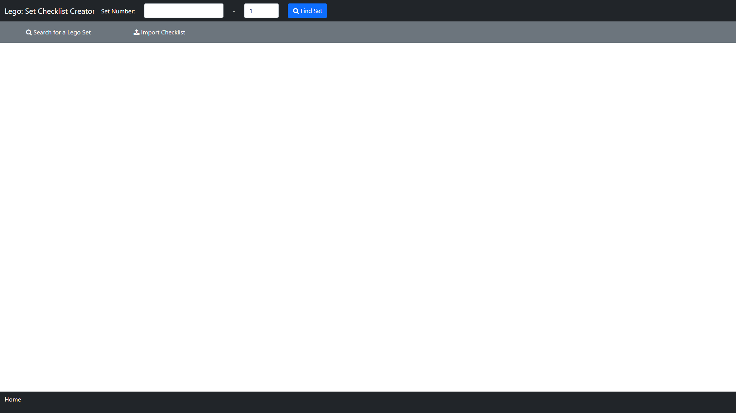
Index

Slide 3
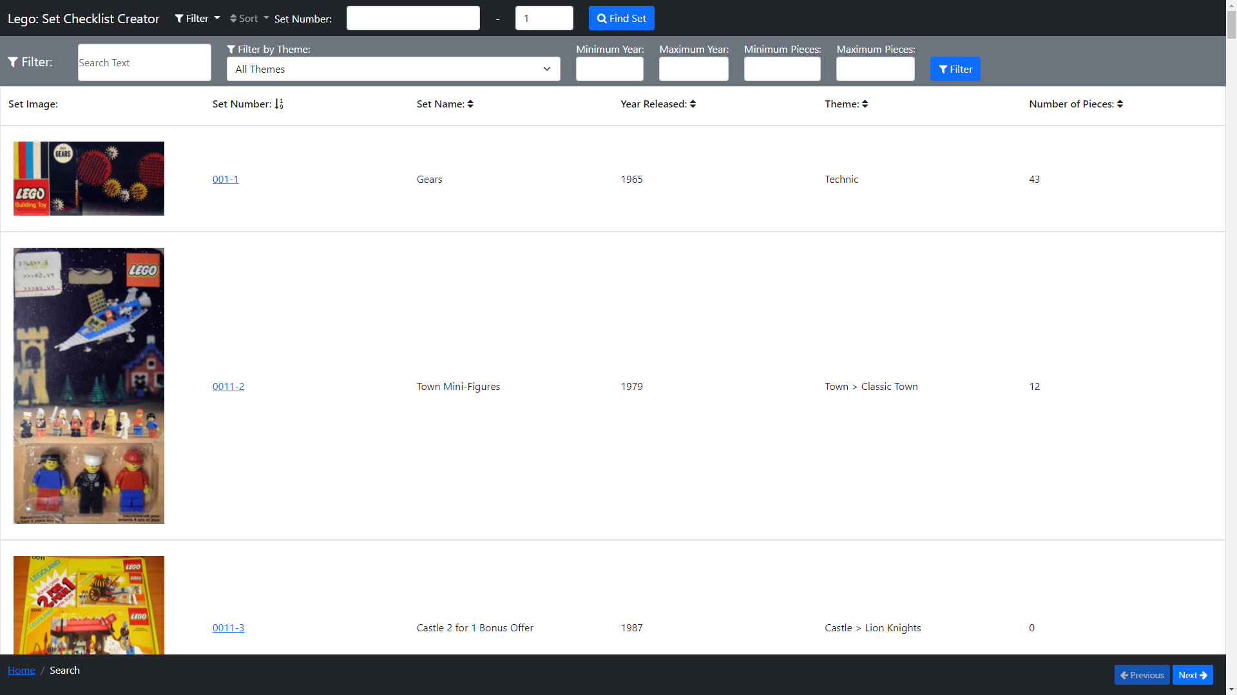
Search

Slide 4
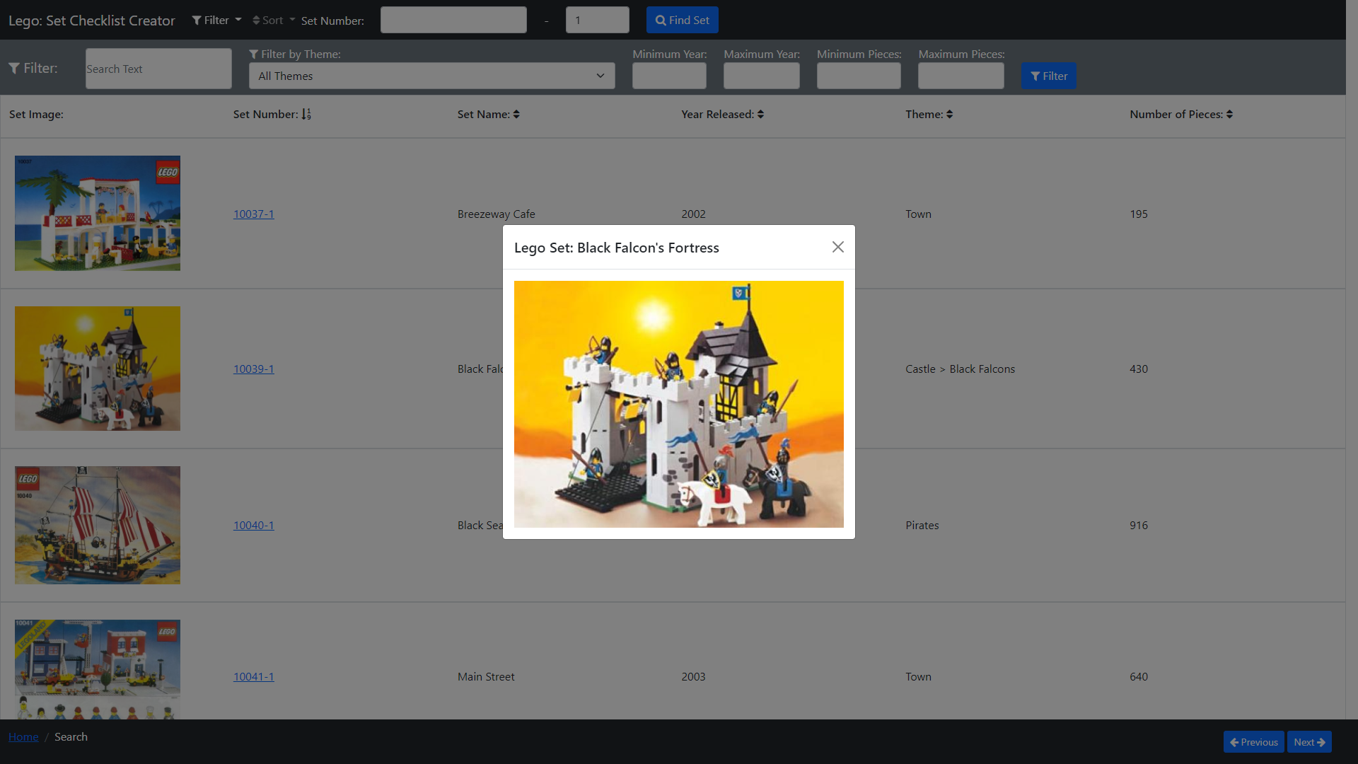
Search – Set Image

Slide 5
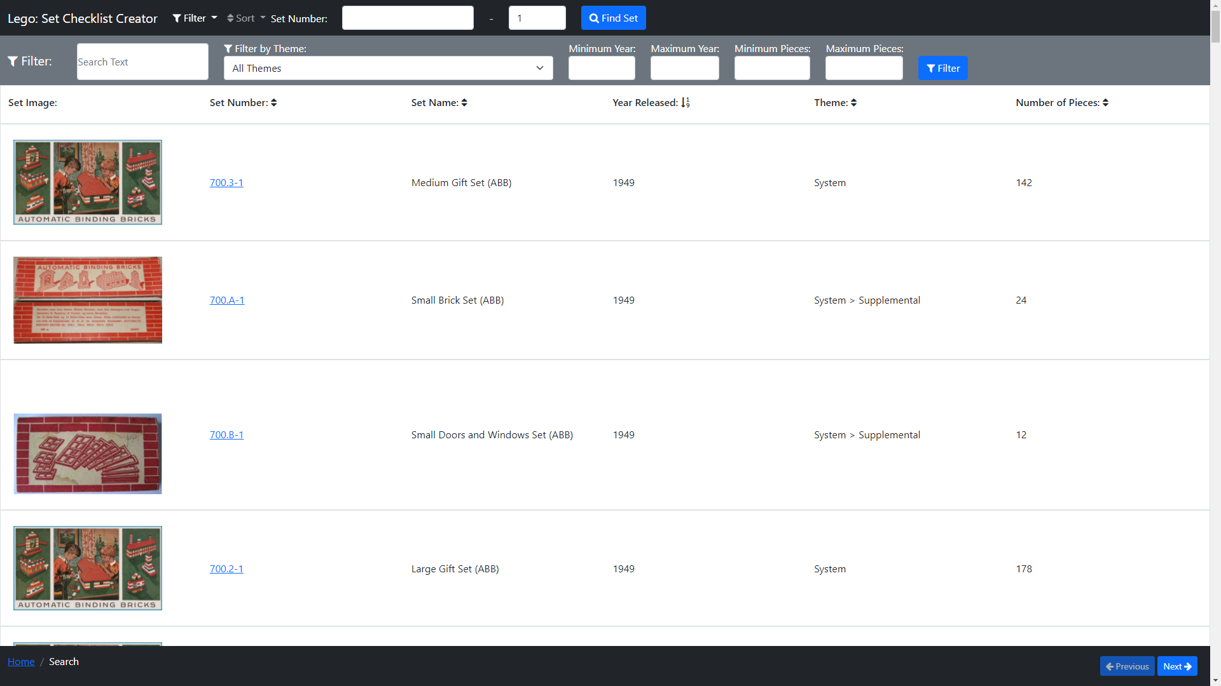
Search – Sort Column Year

Slide 6
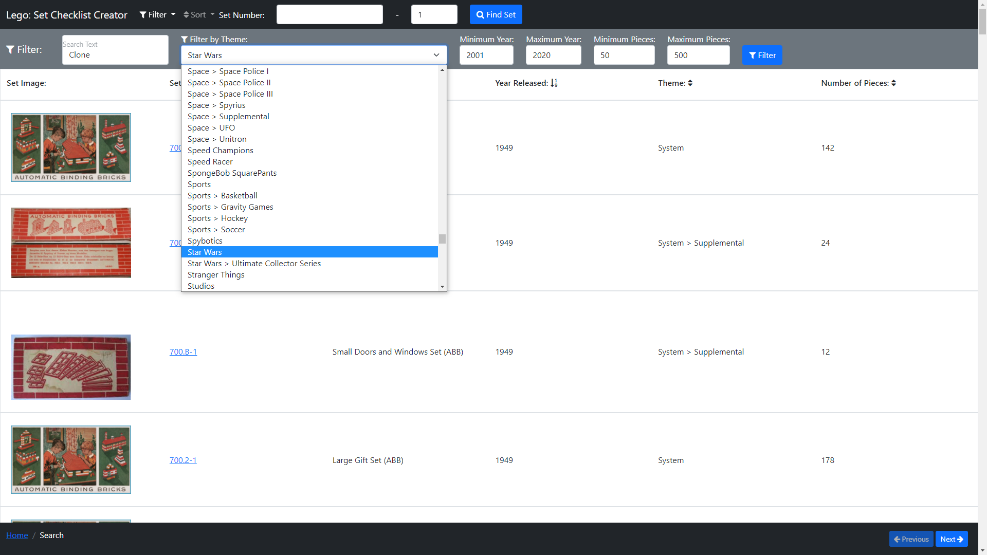
Search – Filter: Set Up

Slide 7
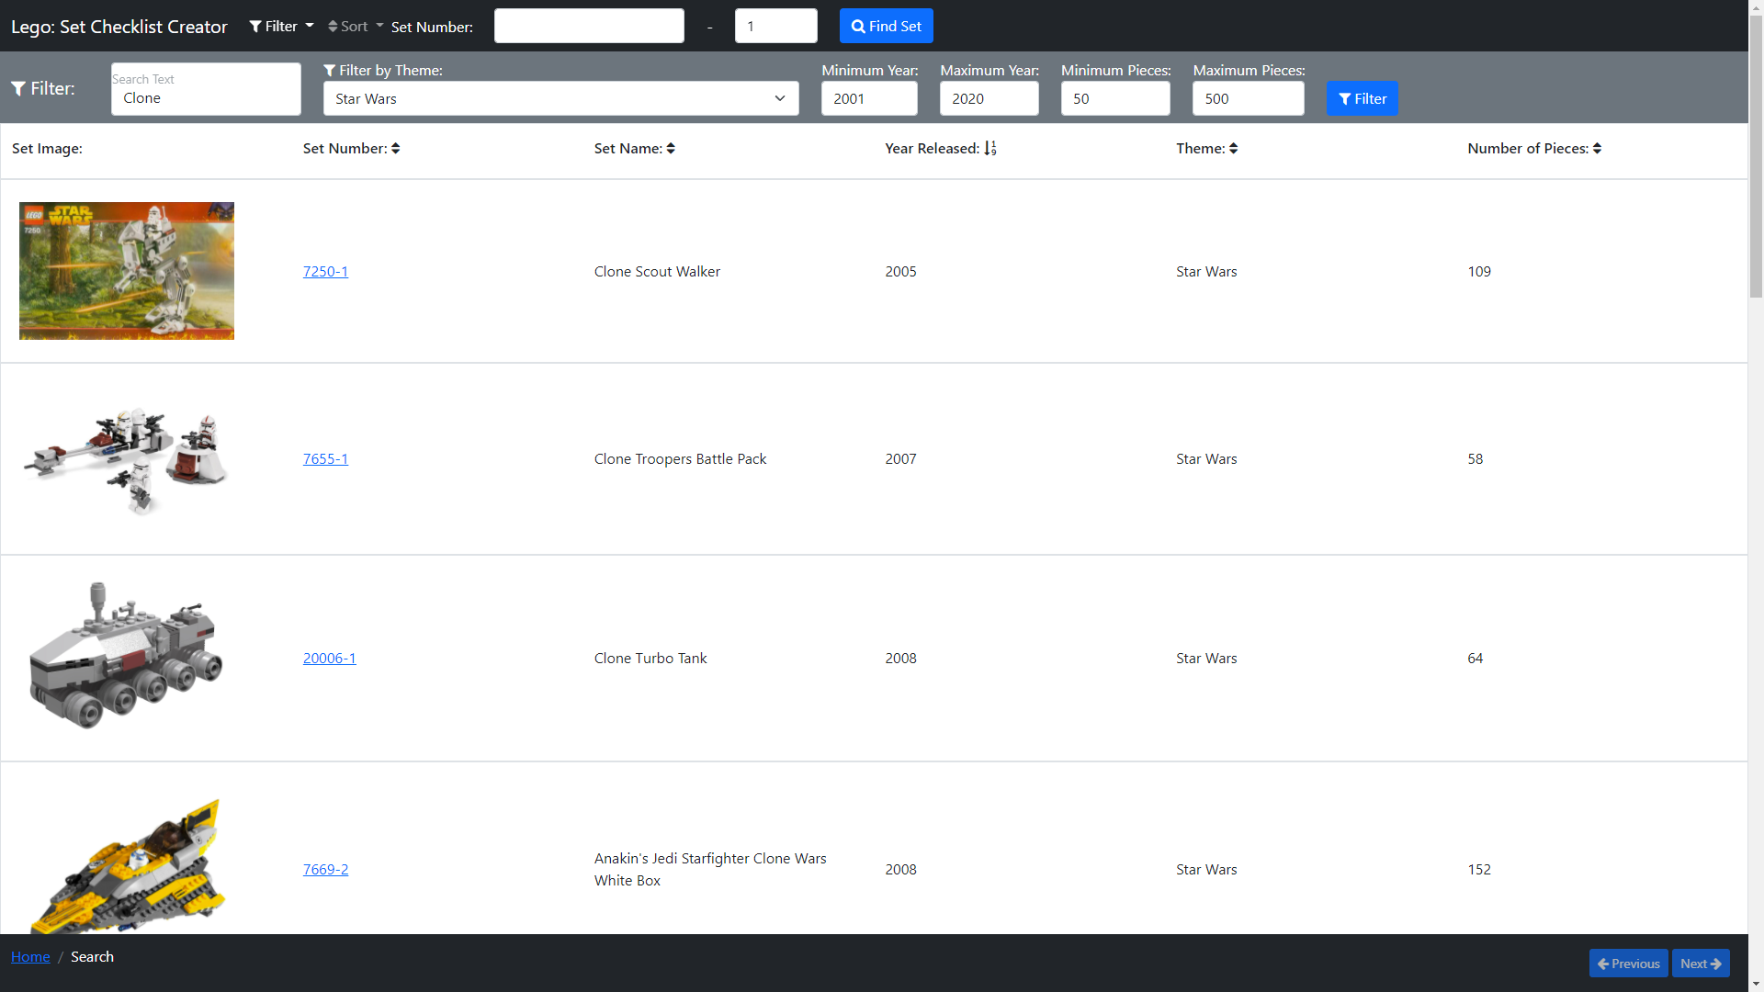
Search – Filtered

Slide 8
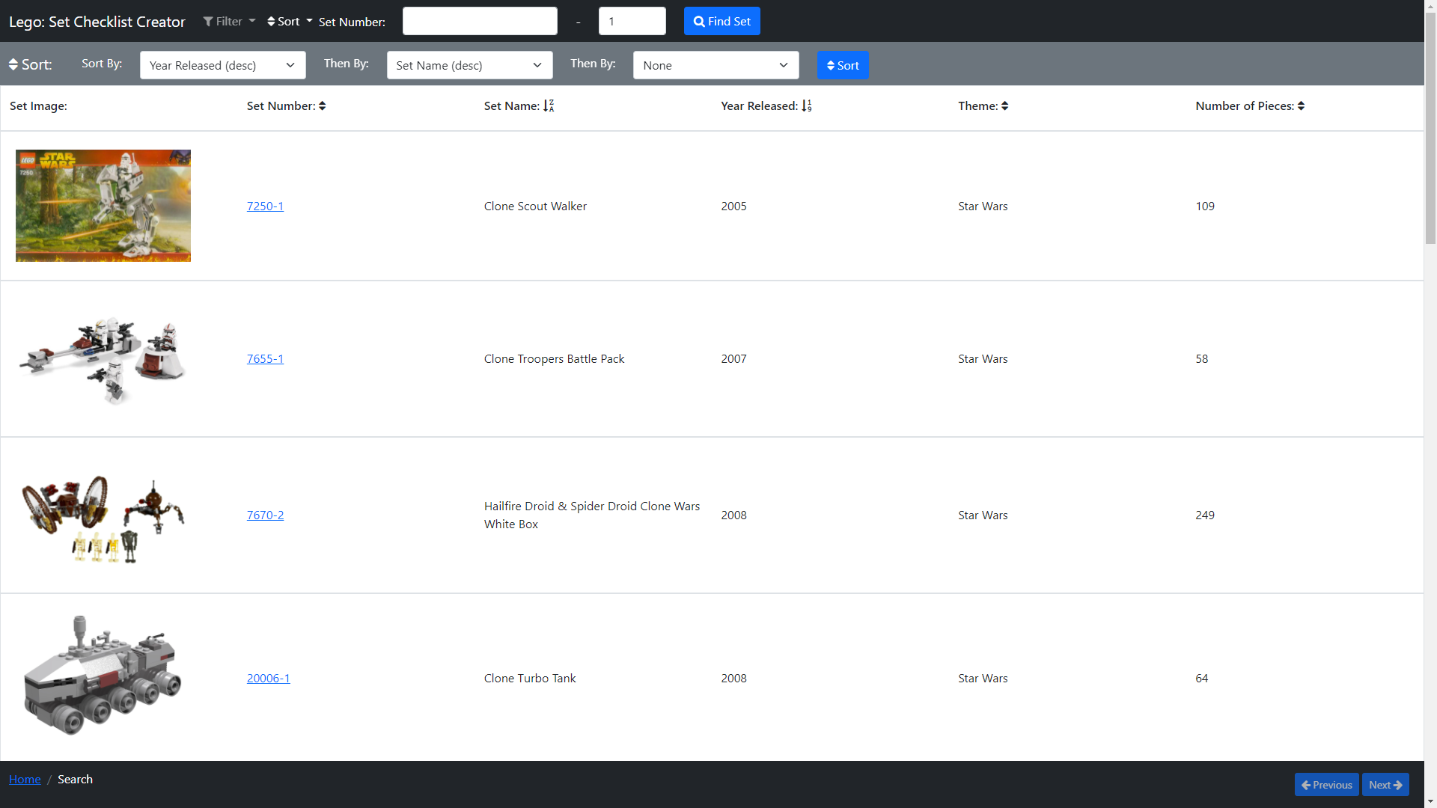
Search – Sort: year(asc), name(desc)

Slide 9
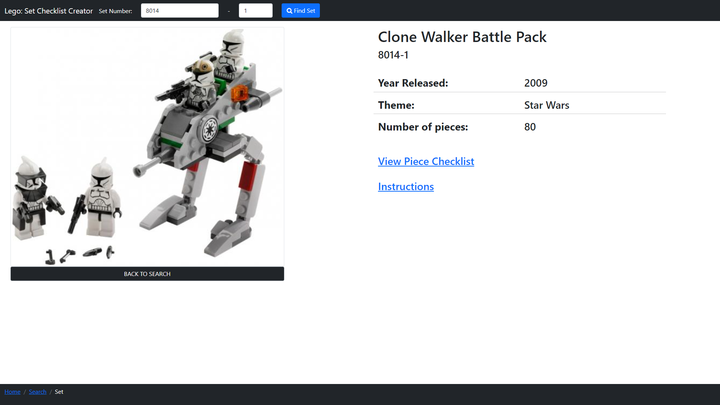
Lego Set – Clone Walker Battle Pack(8014-1)

Slide 10
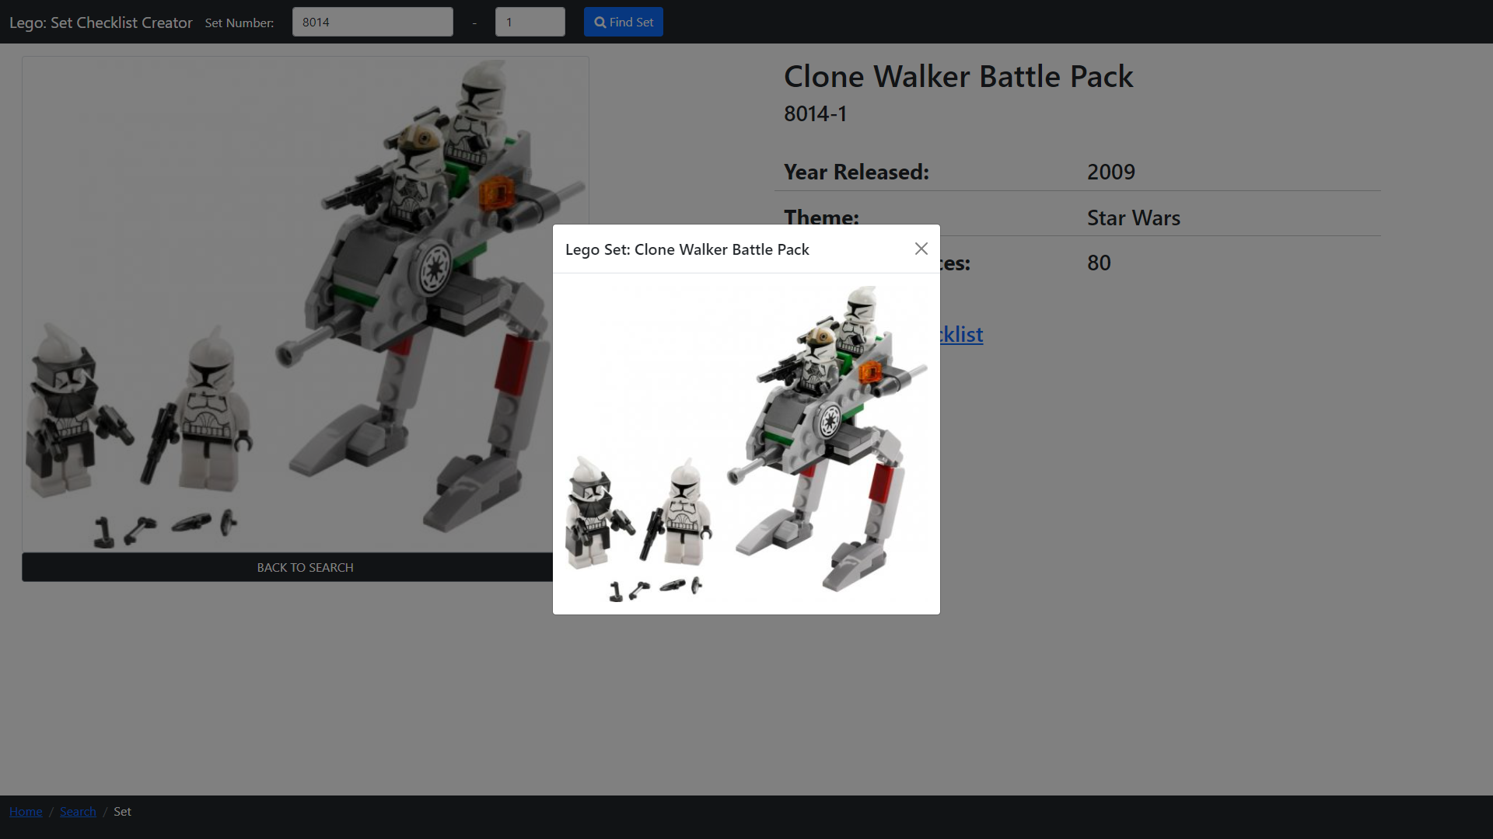
Lego Set – 8014-1 Set Image

Slide 11
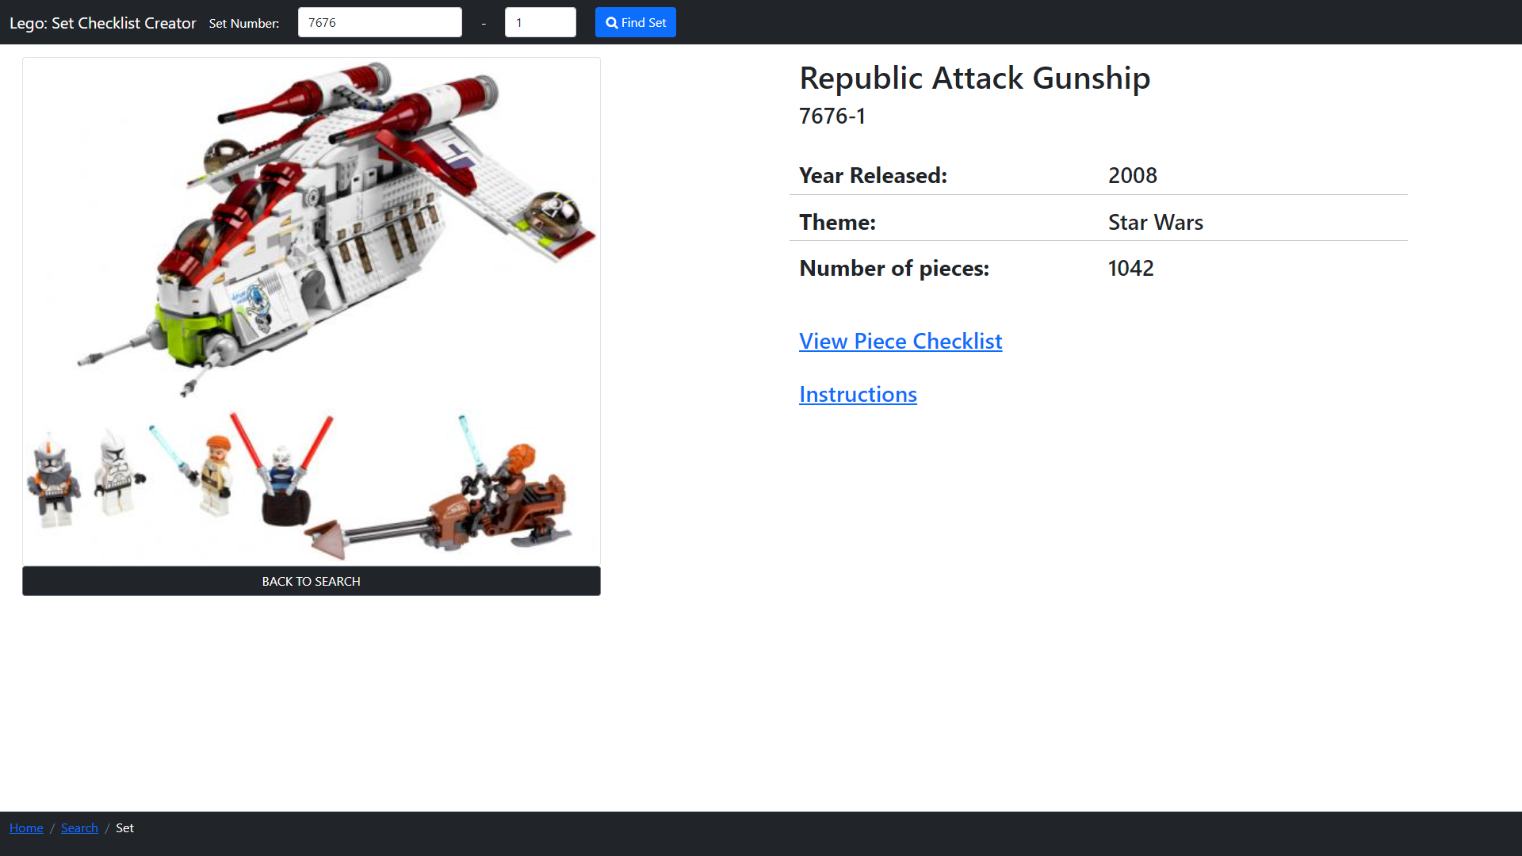
Lego Set – Republic Attack Gunship(7676-1)

Slide 12
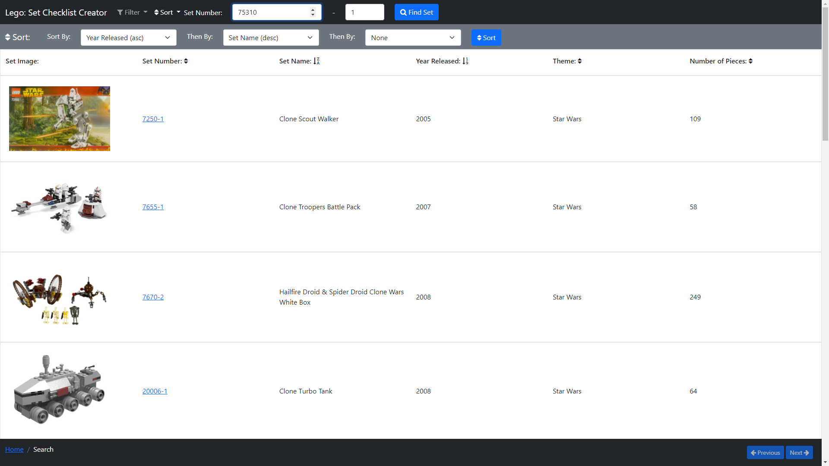
Search – Back To Search, Type Set Number 75310-1

Slide 13
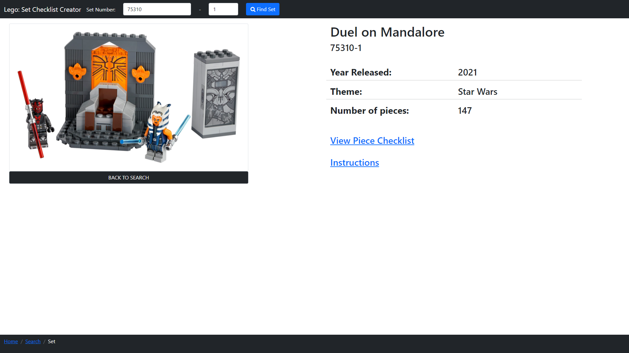
Lego Set – Duel on Mandalore(75310-1)

Slide 14
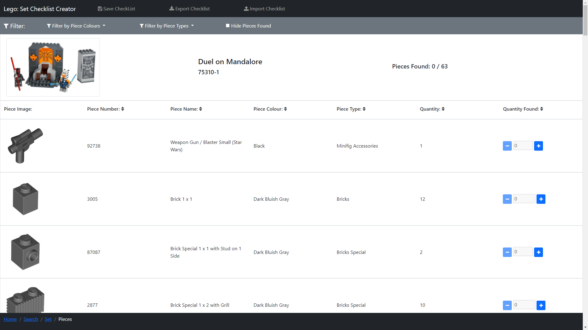
Lego Pieces – Duel on Mandalore(75310-1)

Slide 15
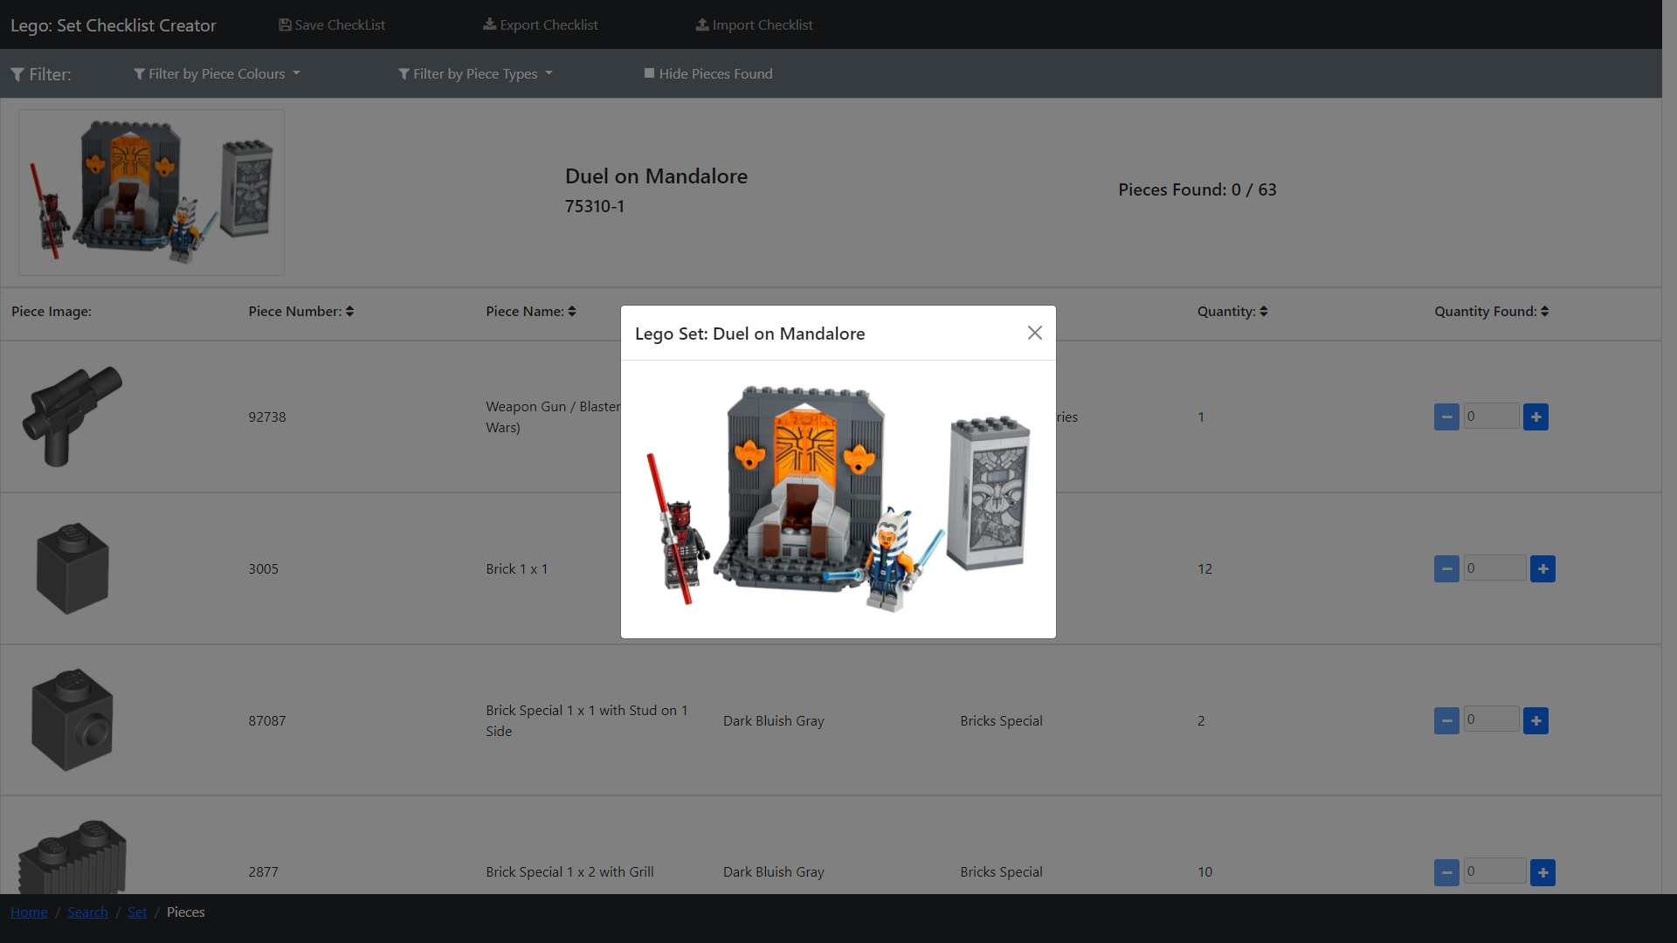
Lego Pieces – 75310-1 Set Image

Slide 16
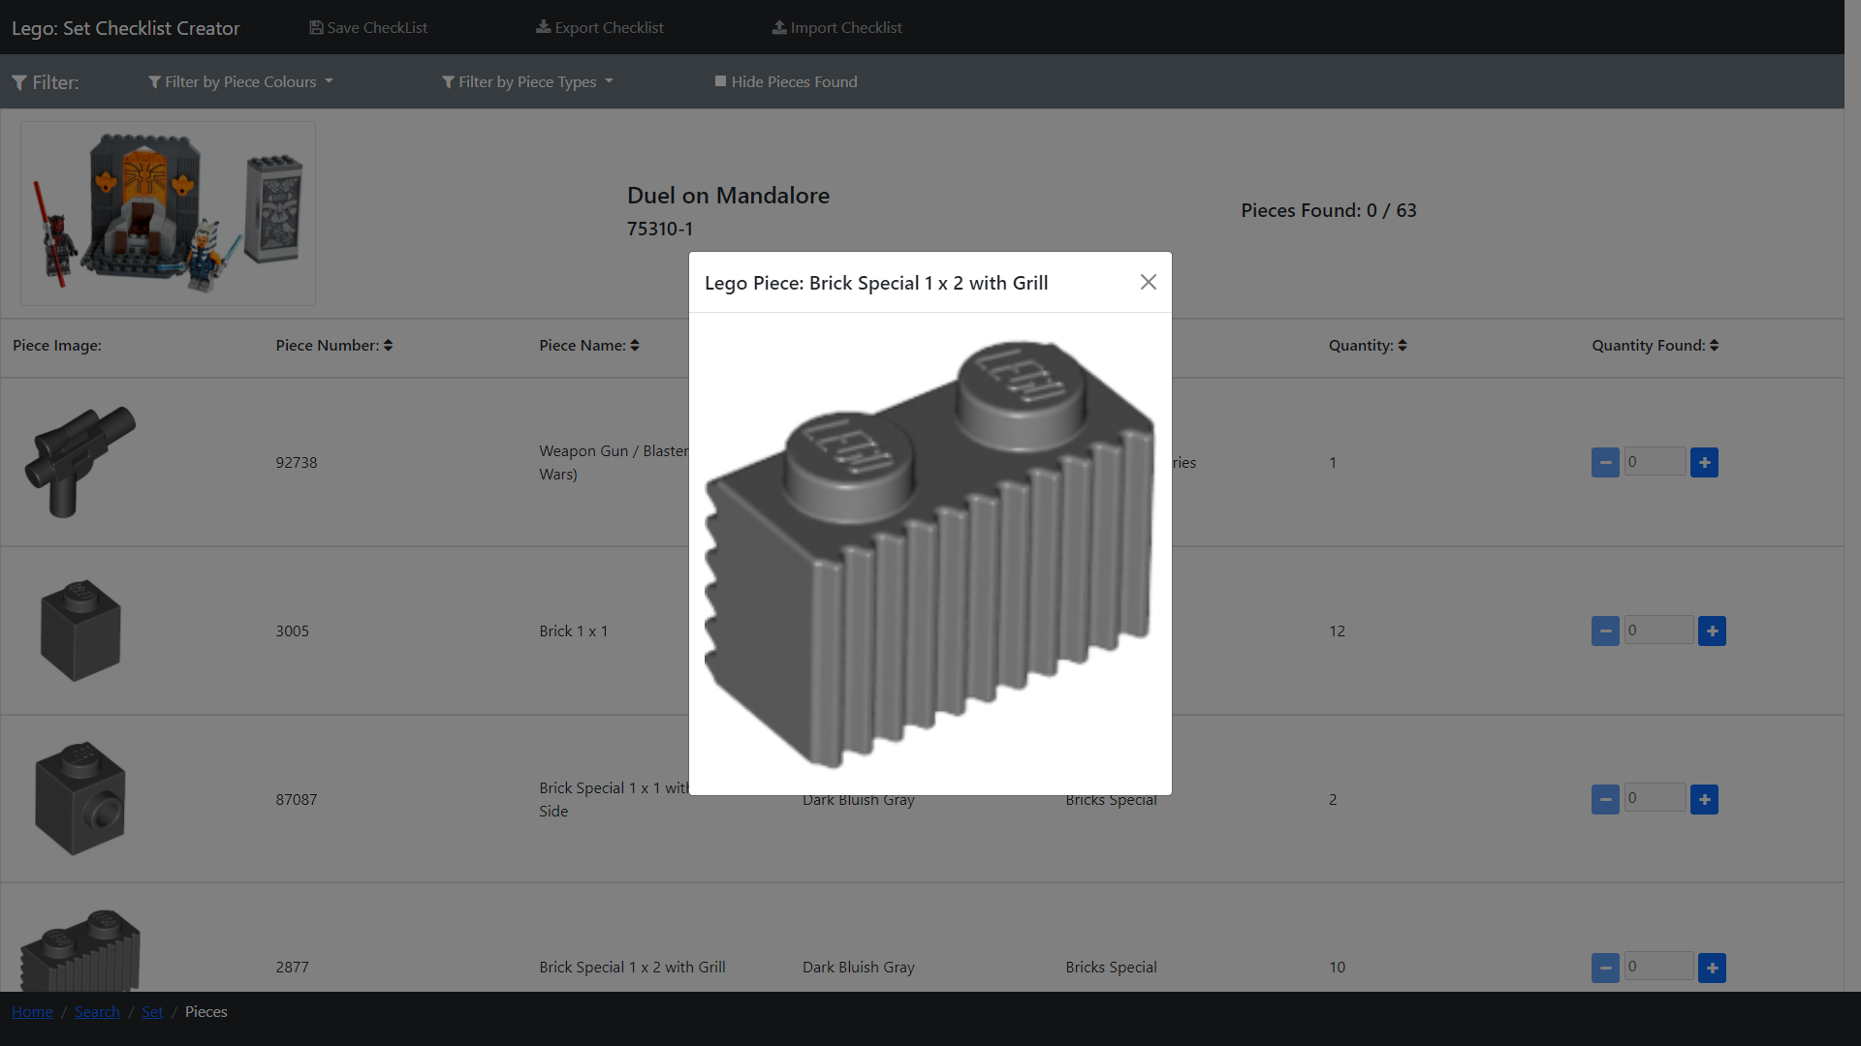
Lego Pieces – 75310-1 Piece Image

Slide 17
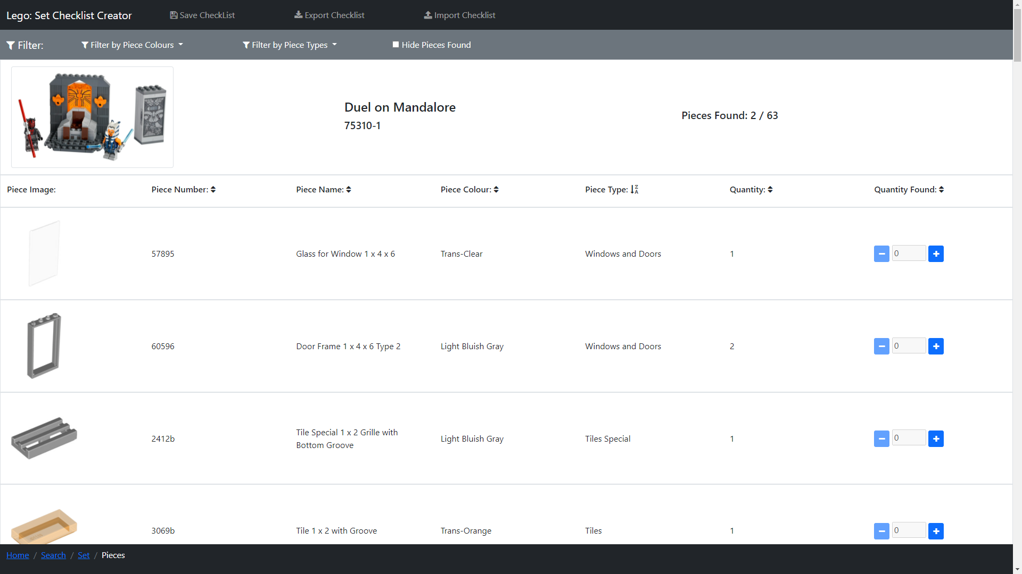
Lego Pieces – 75310-1 Sort

Slide 18
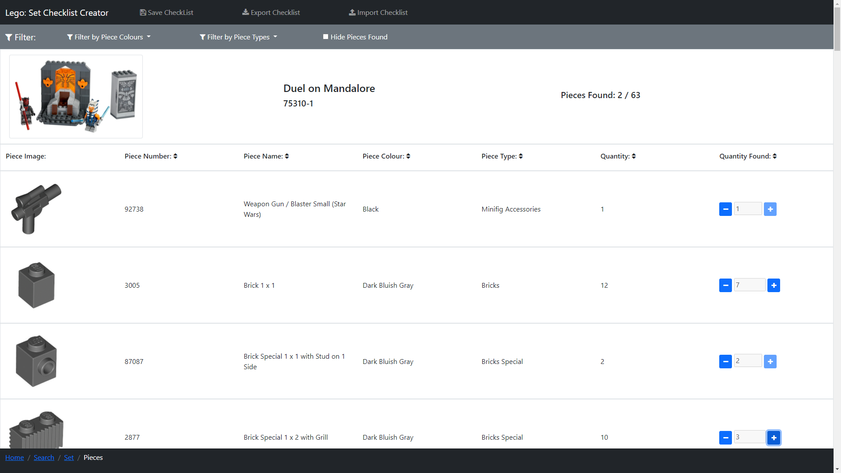
Lego Pieces – 75310-1 Checked Pieces

Slide 19
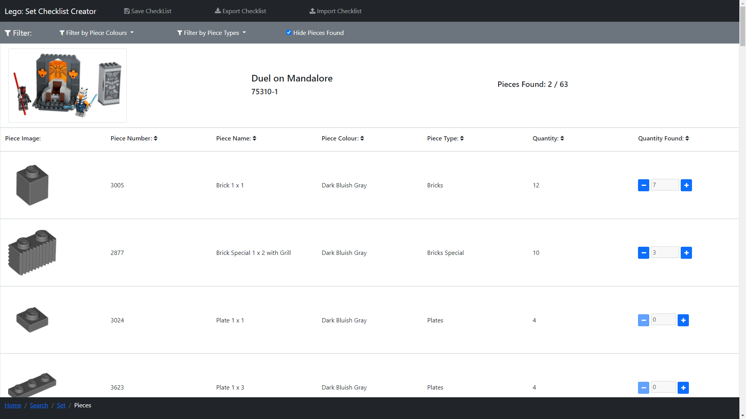
Lego Pieces – 75310-1 Hide Checked Pieces

Slide 20
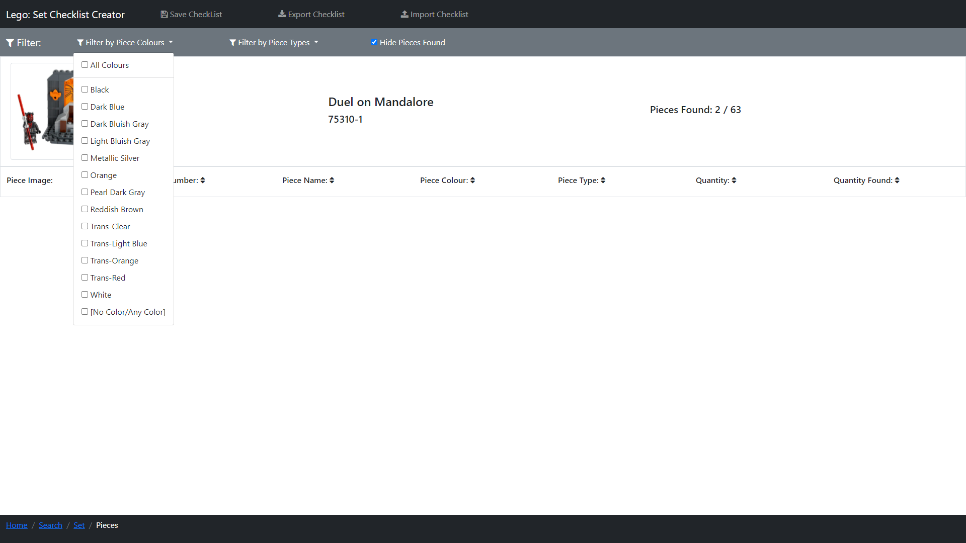
Lego Pieces – 75310-1 Filter: No Colours

Slide 21
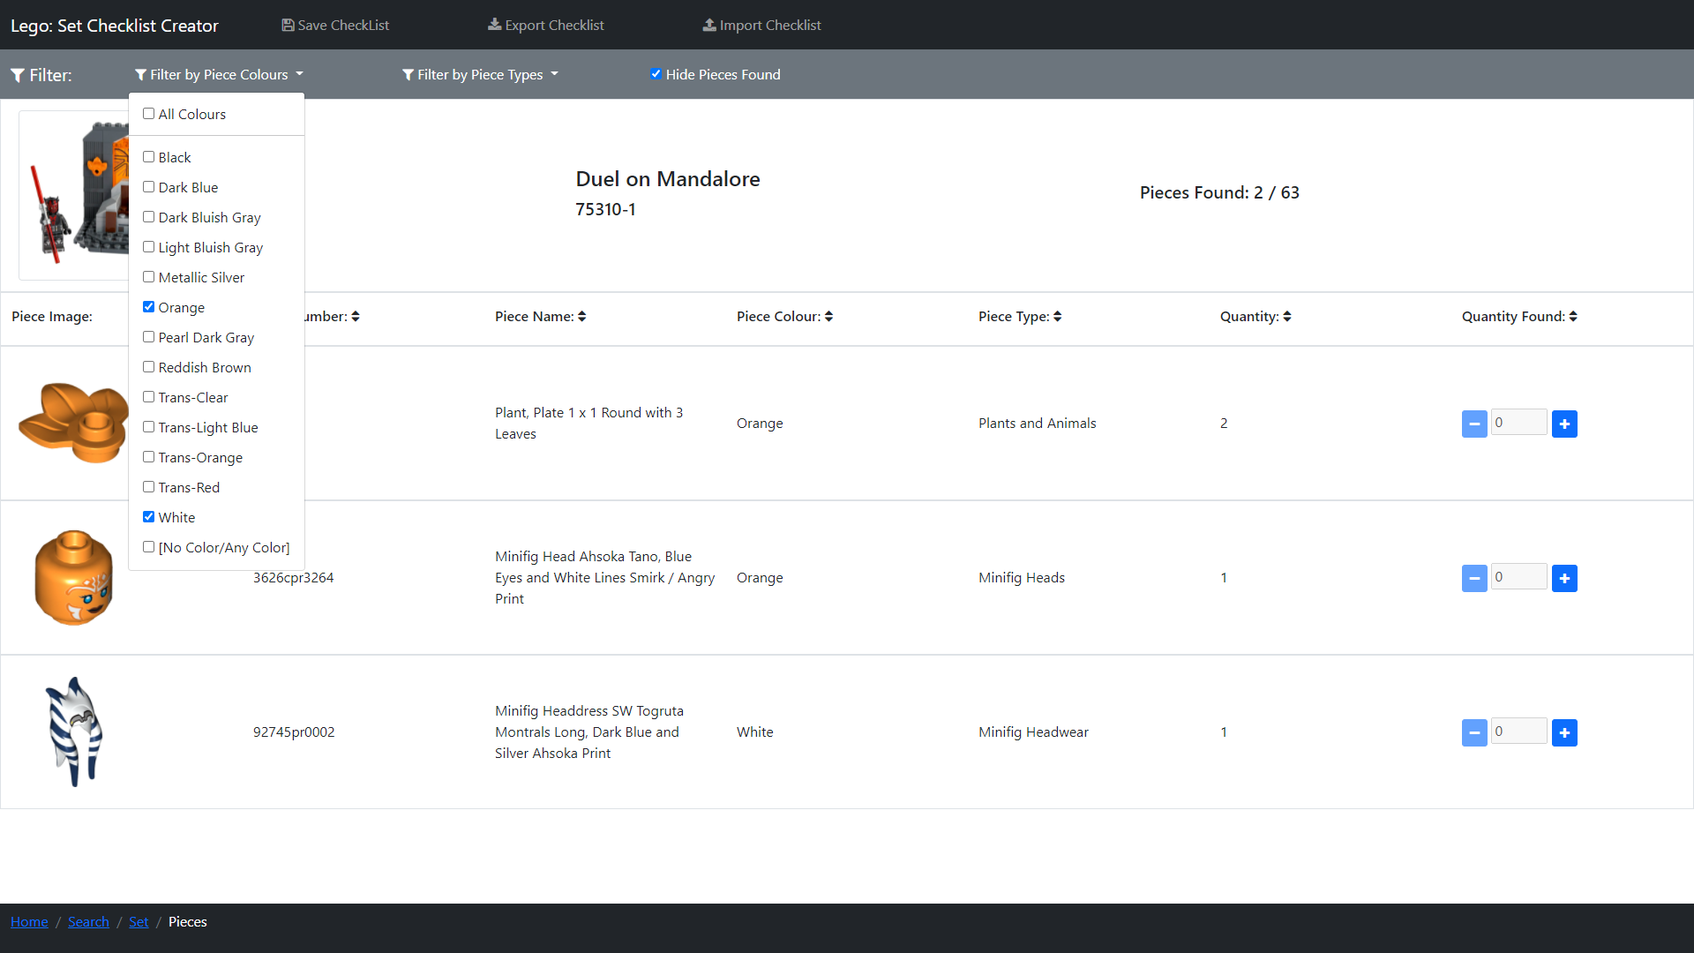
Lego Pieces – 75310-1 Filter: White & Orange

Slide 22
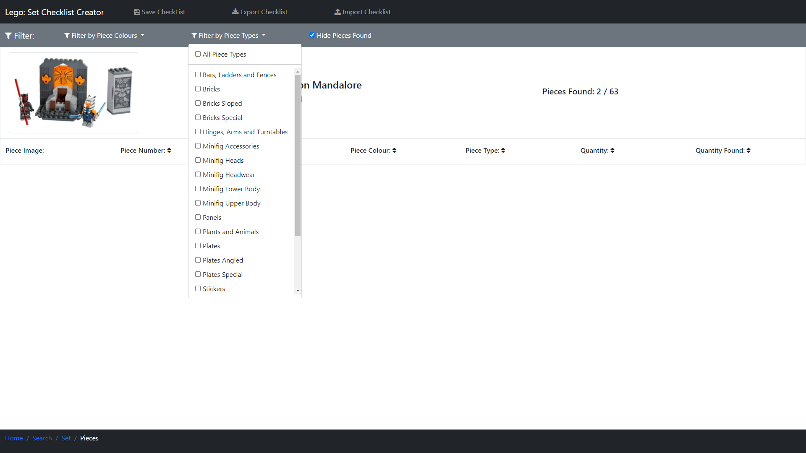
Lego Pieces – 75310-1 Filter: No Piece Types

Slide 23
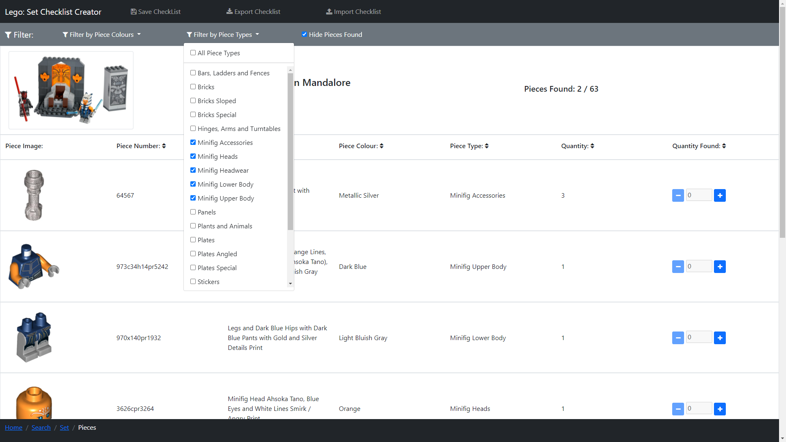
Lego Pieces – 75310-1 Filter: Minifigure Piece Types

Slide 24
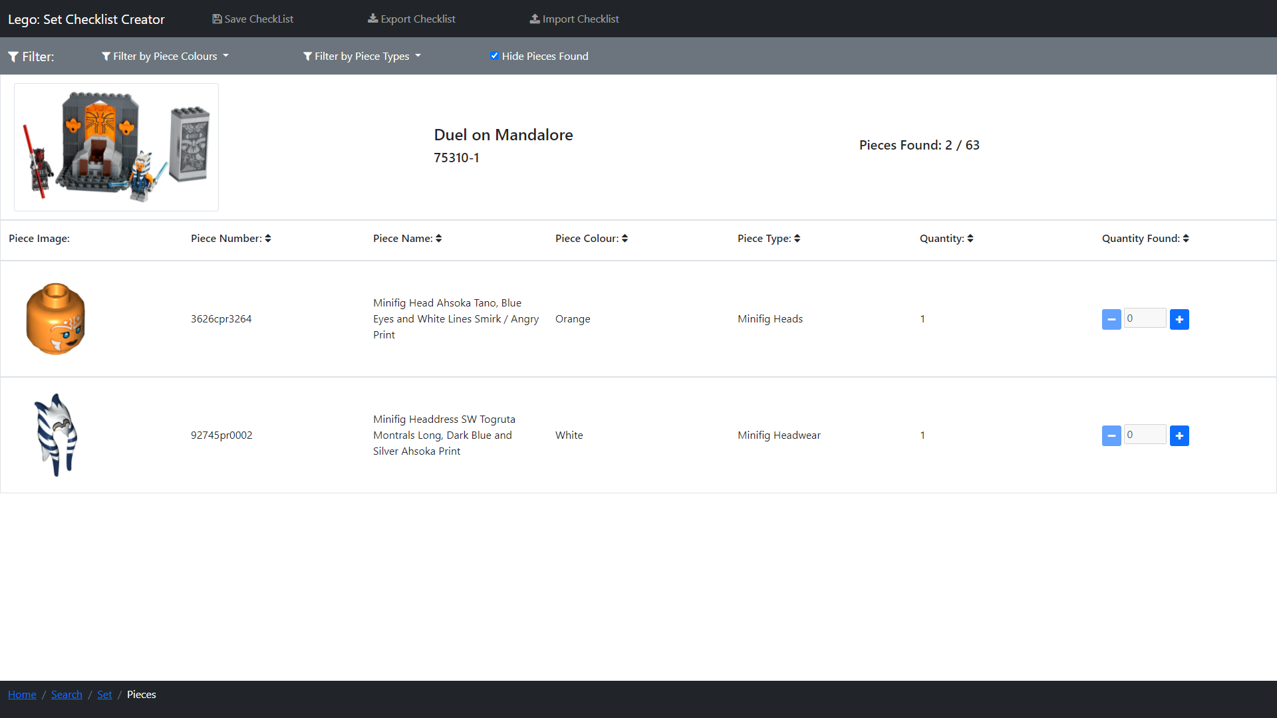
Lego Pieces – 75310-1 Filter: Colour & Type

Slide 25
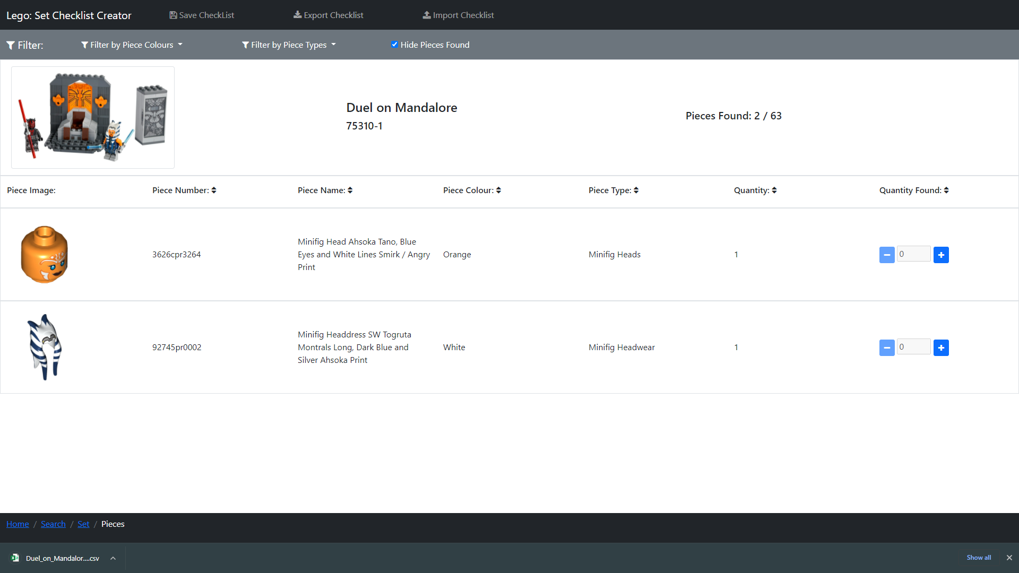
Lego Pieces – 75310-1 Export

Slide 26
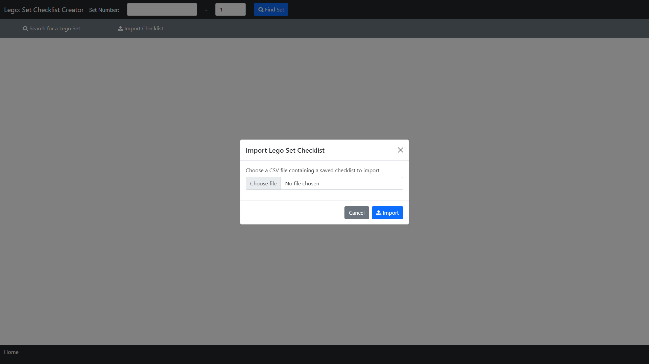
Index – Import 75310-1

Slide 27
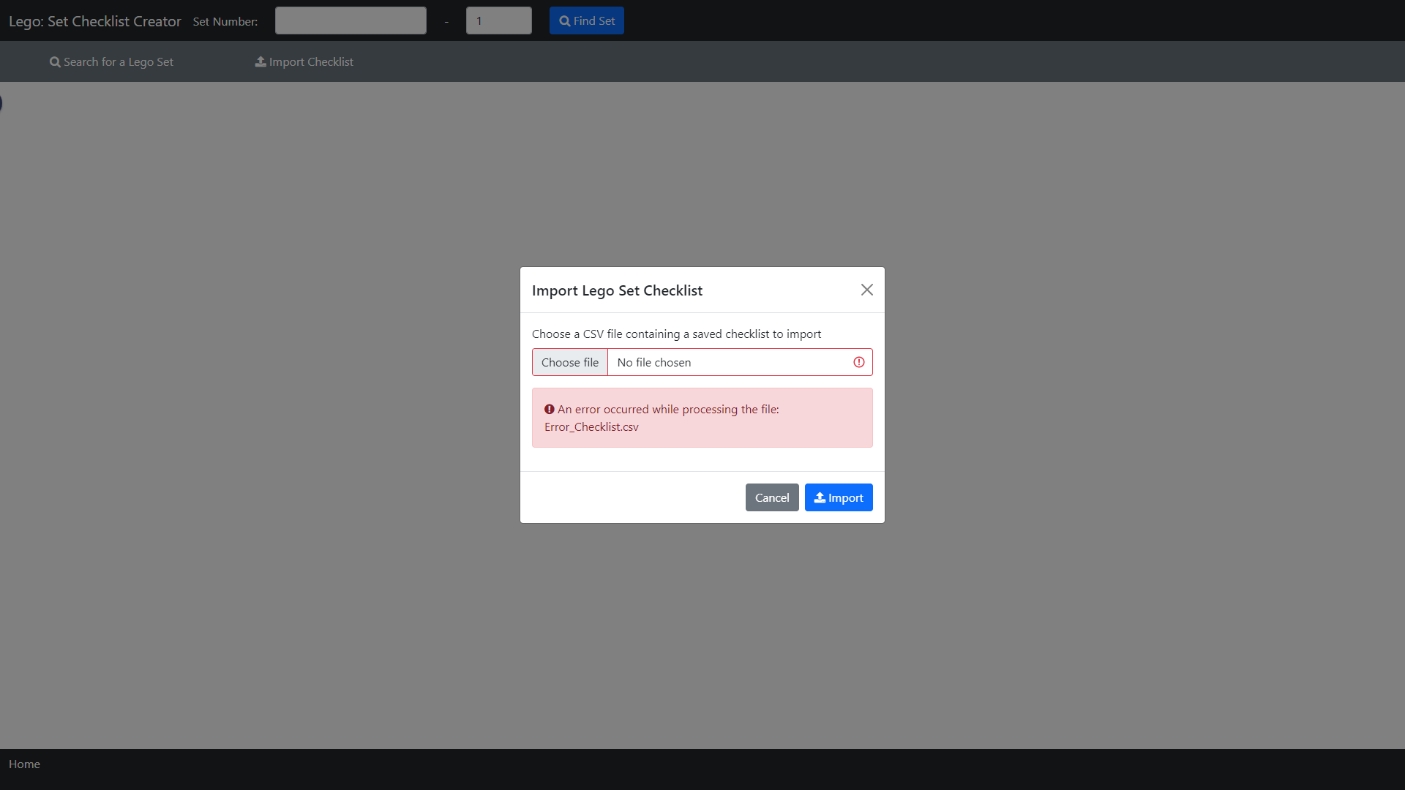
Index – Import 75310-1: Error Processing

Slide 28
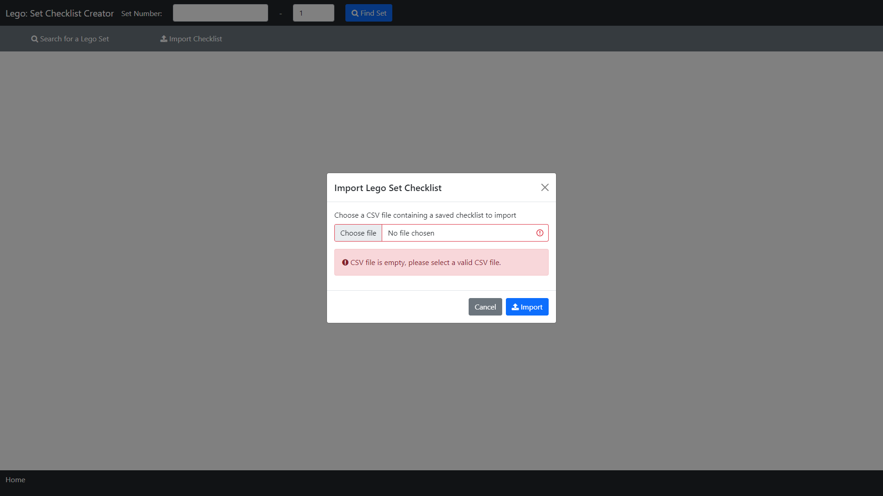
Index – Import 75310-1: Error CSV File Empty

Slide 29
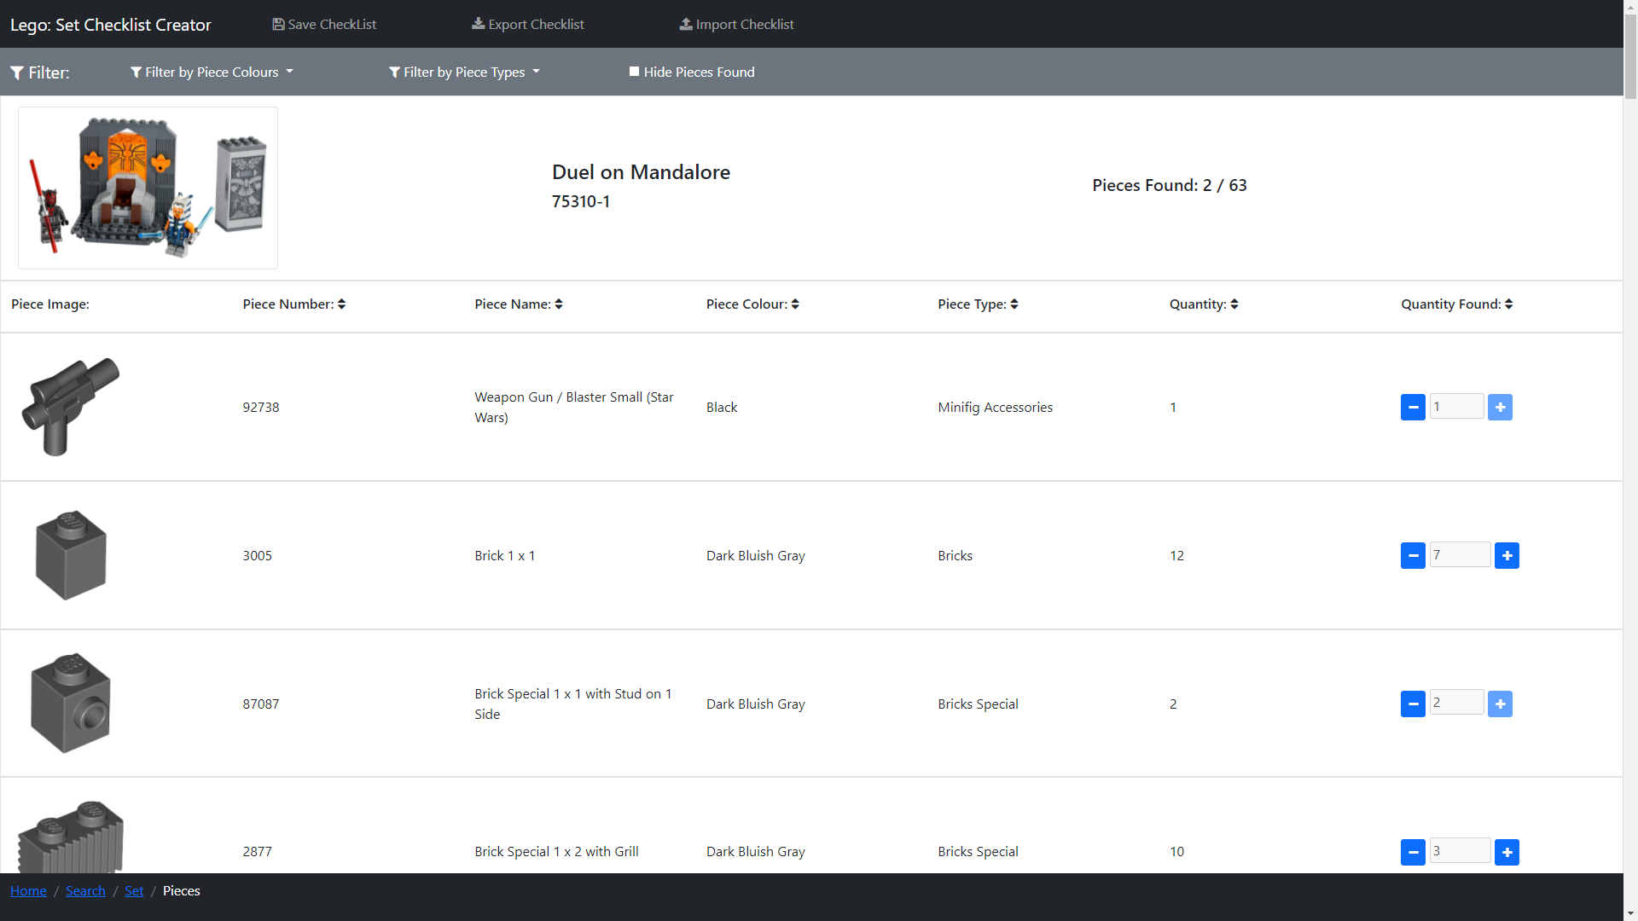
Lego Pieces – 75310-1 Imported Checklist

Slide 30
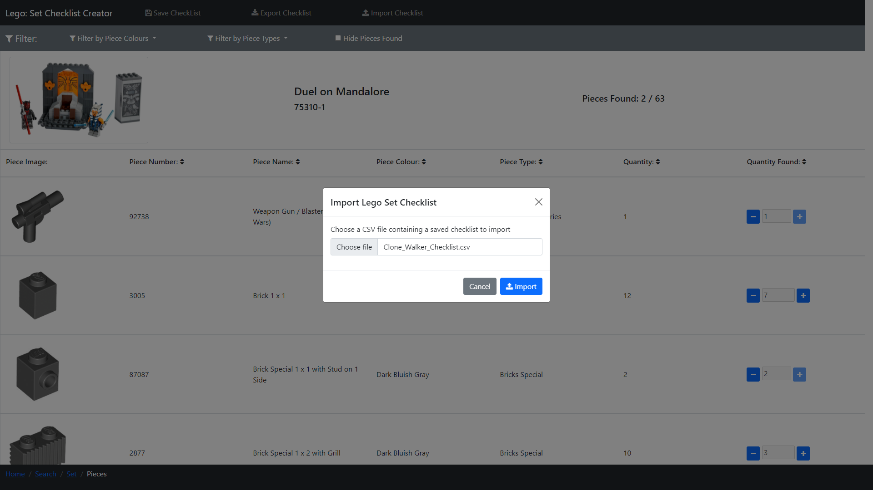
Lego Pieces – Import 30006-1

Slide 31
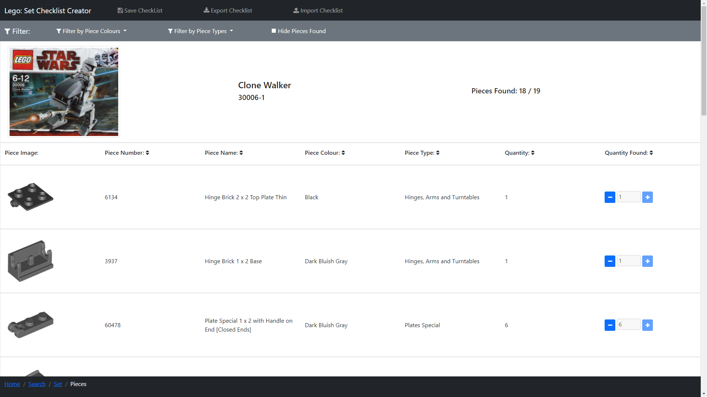
Lego Pieces – 30006-1 Imported Checklist

